Slide 1


ER DIAGRAM OVERVIEW
FOR ACOUSTICA

Slide 2



Acoustica
A DBMS BASED MUSIC STREAMING PLATFORM

Slide 3
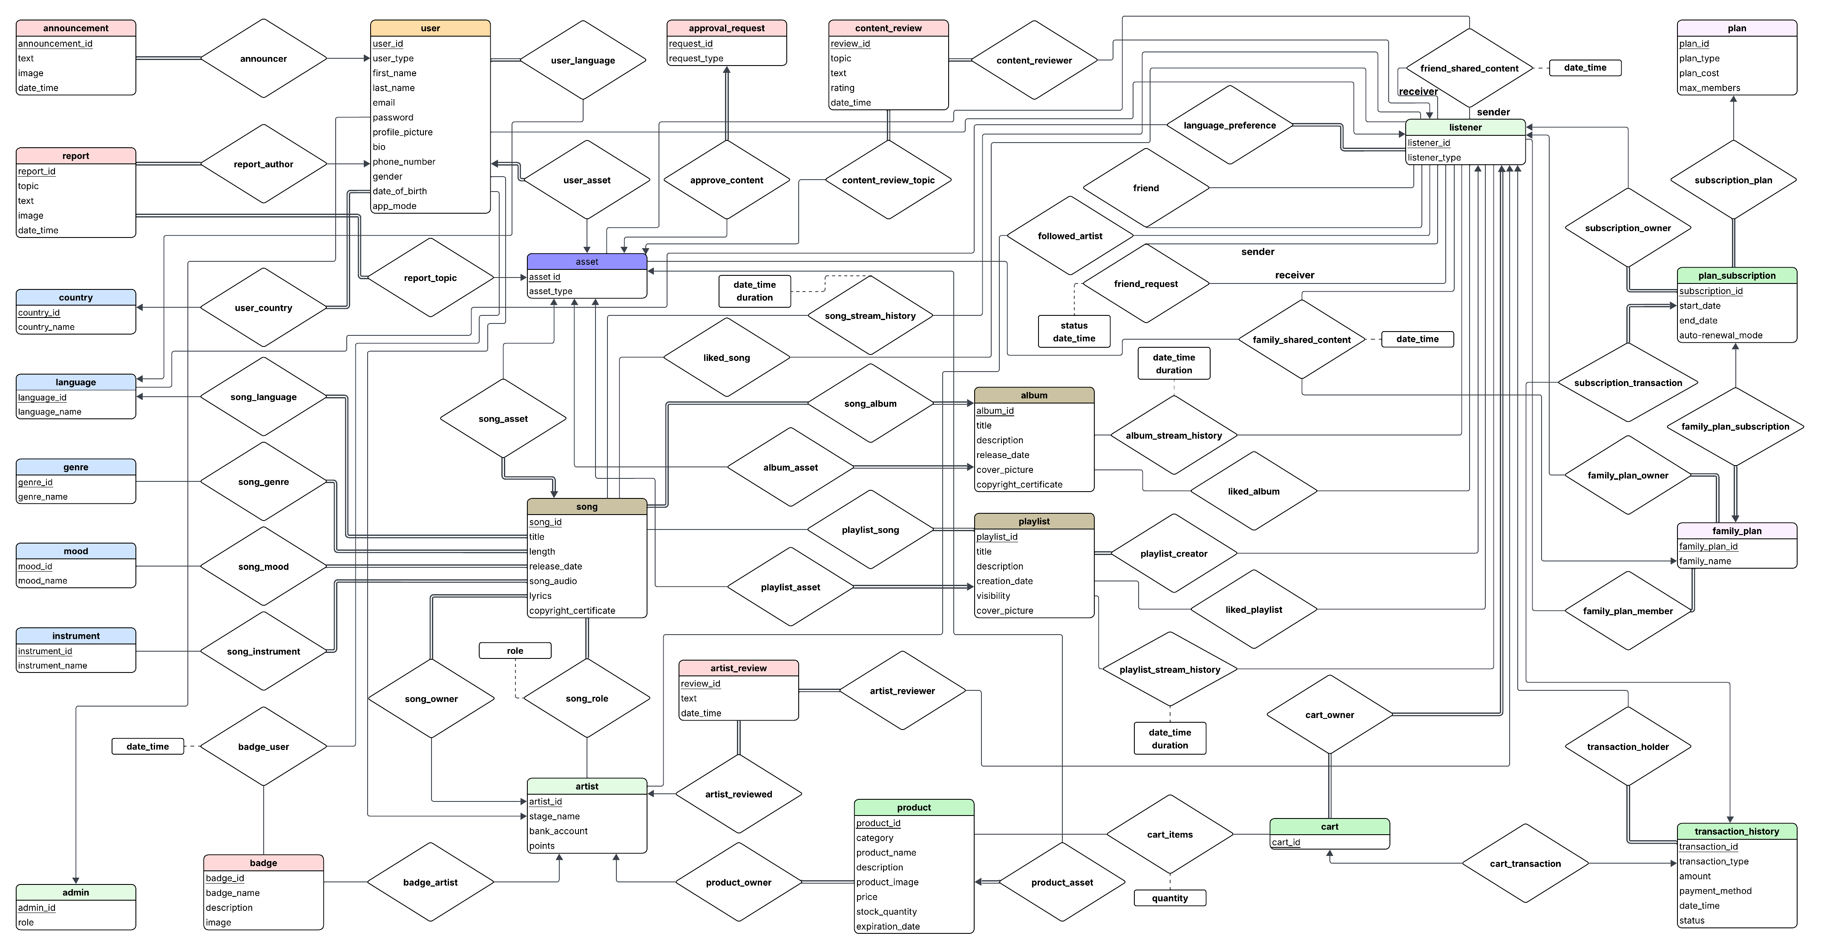

Slide 4
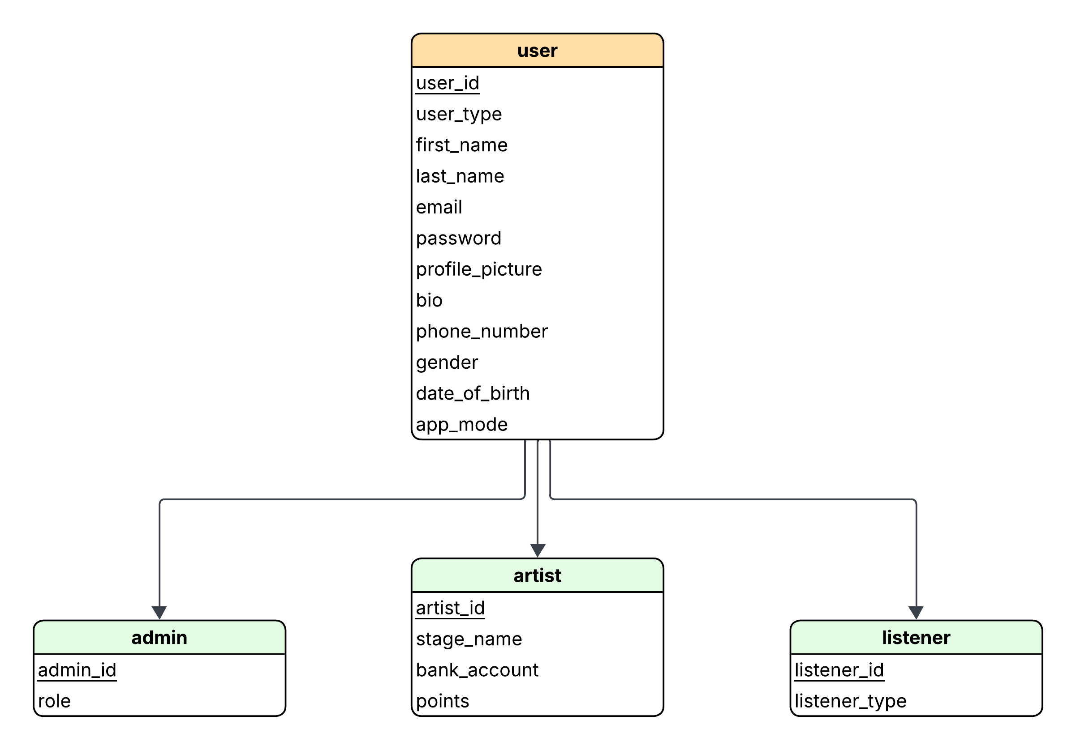
User

Slide 5
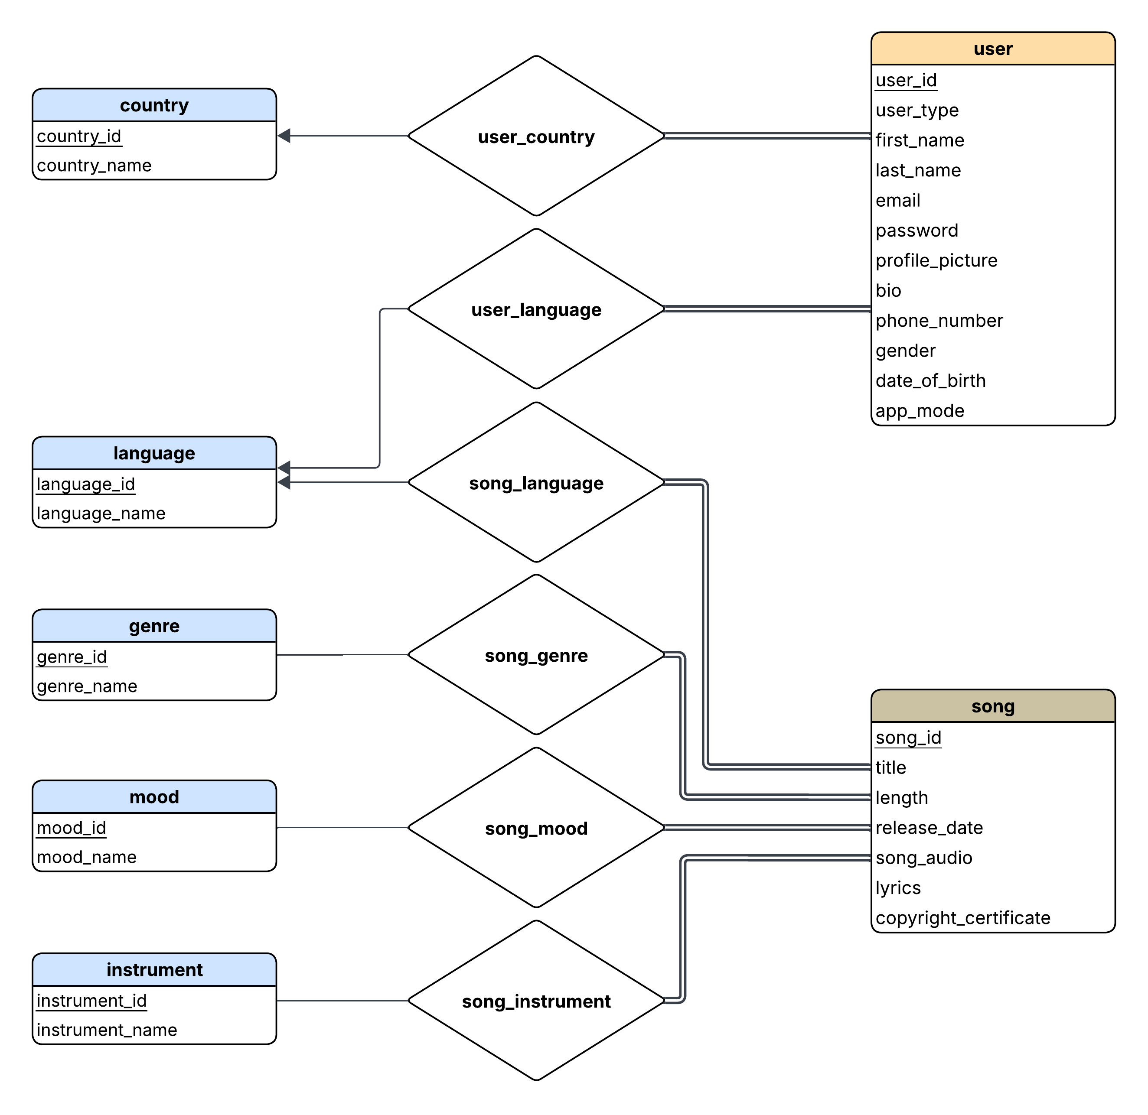
Domain

Slide 6
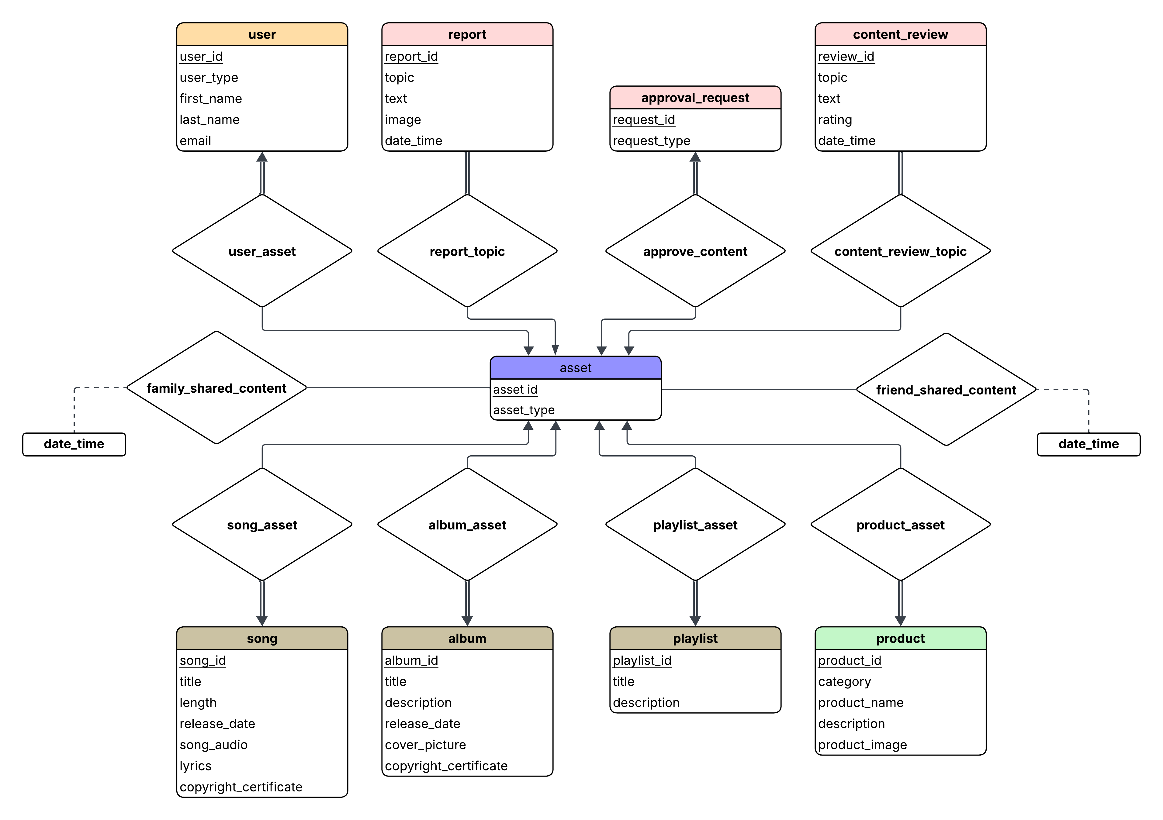
Asset

Slide 7
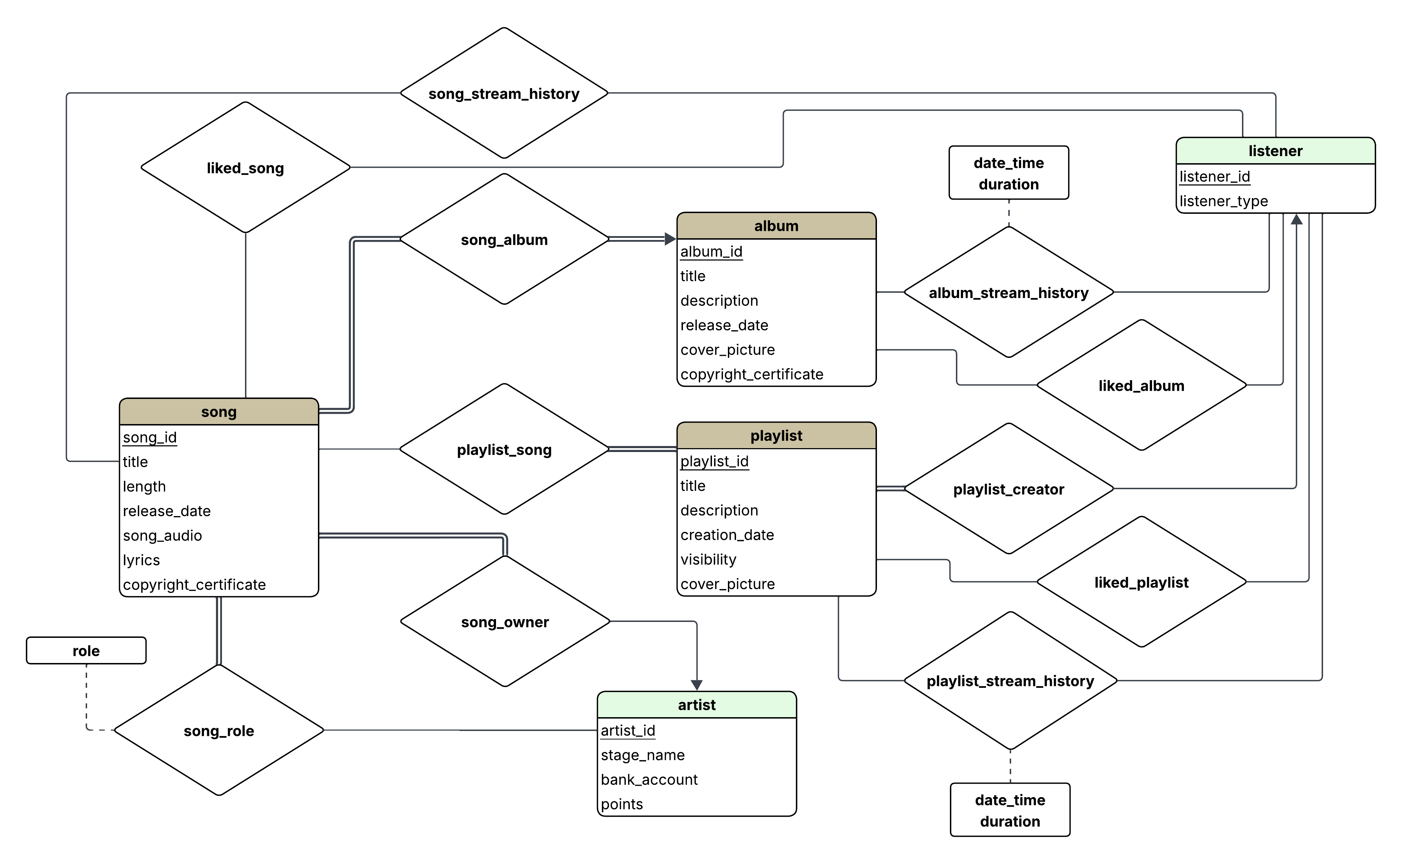
Song

Slide 8
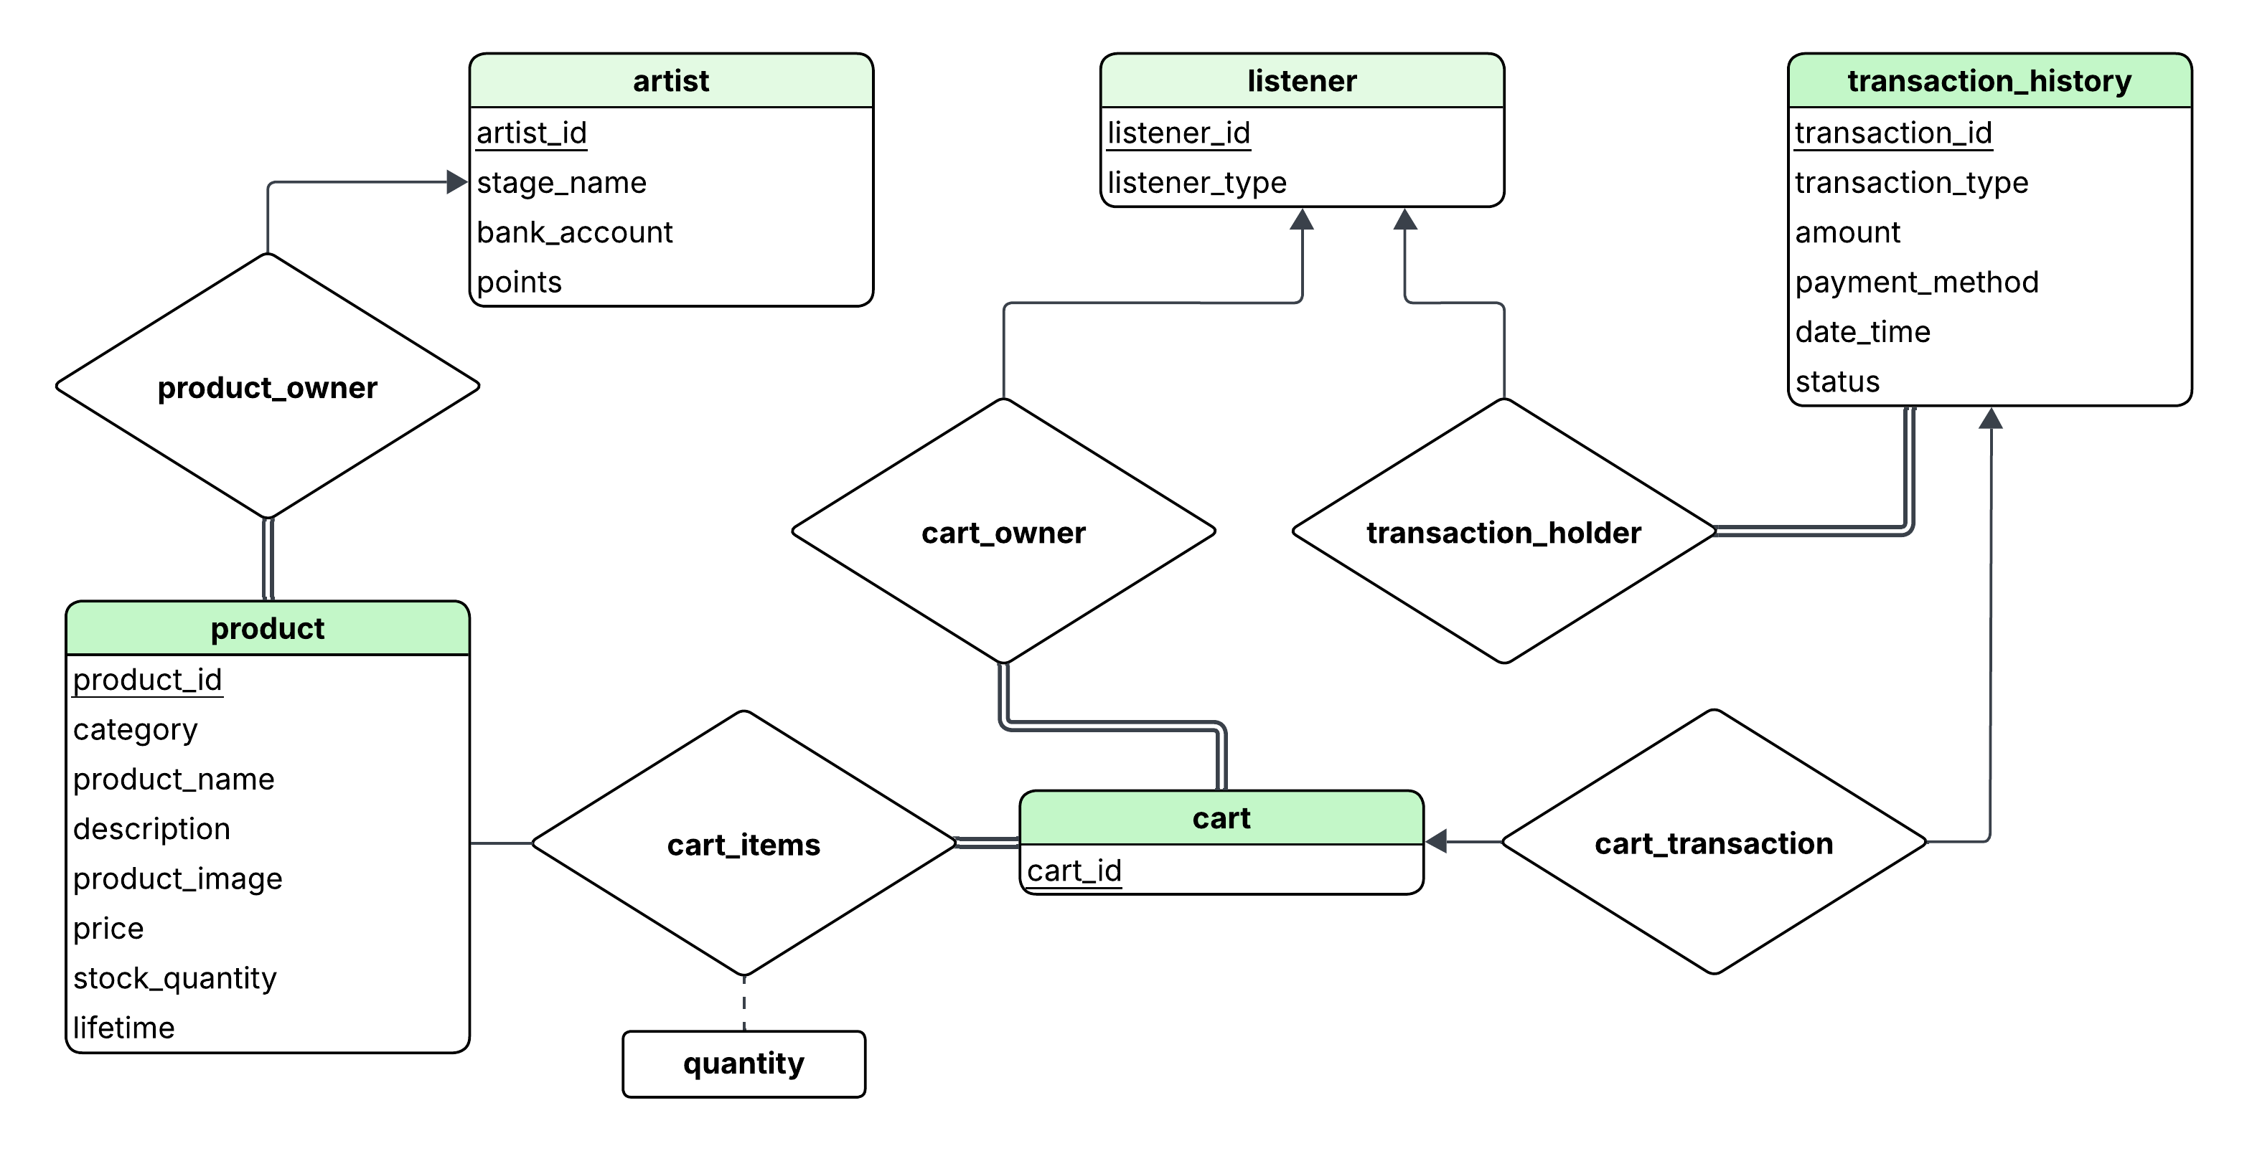
Product

Slide 9
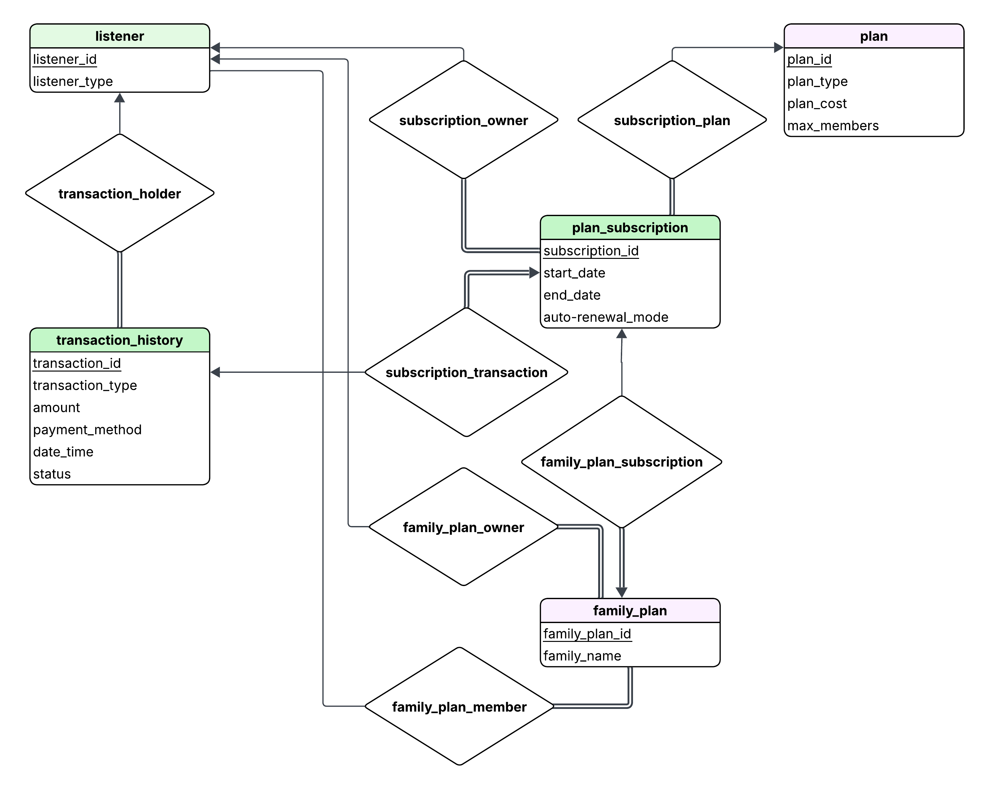
Subscription Model

Slide 10
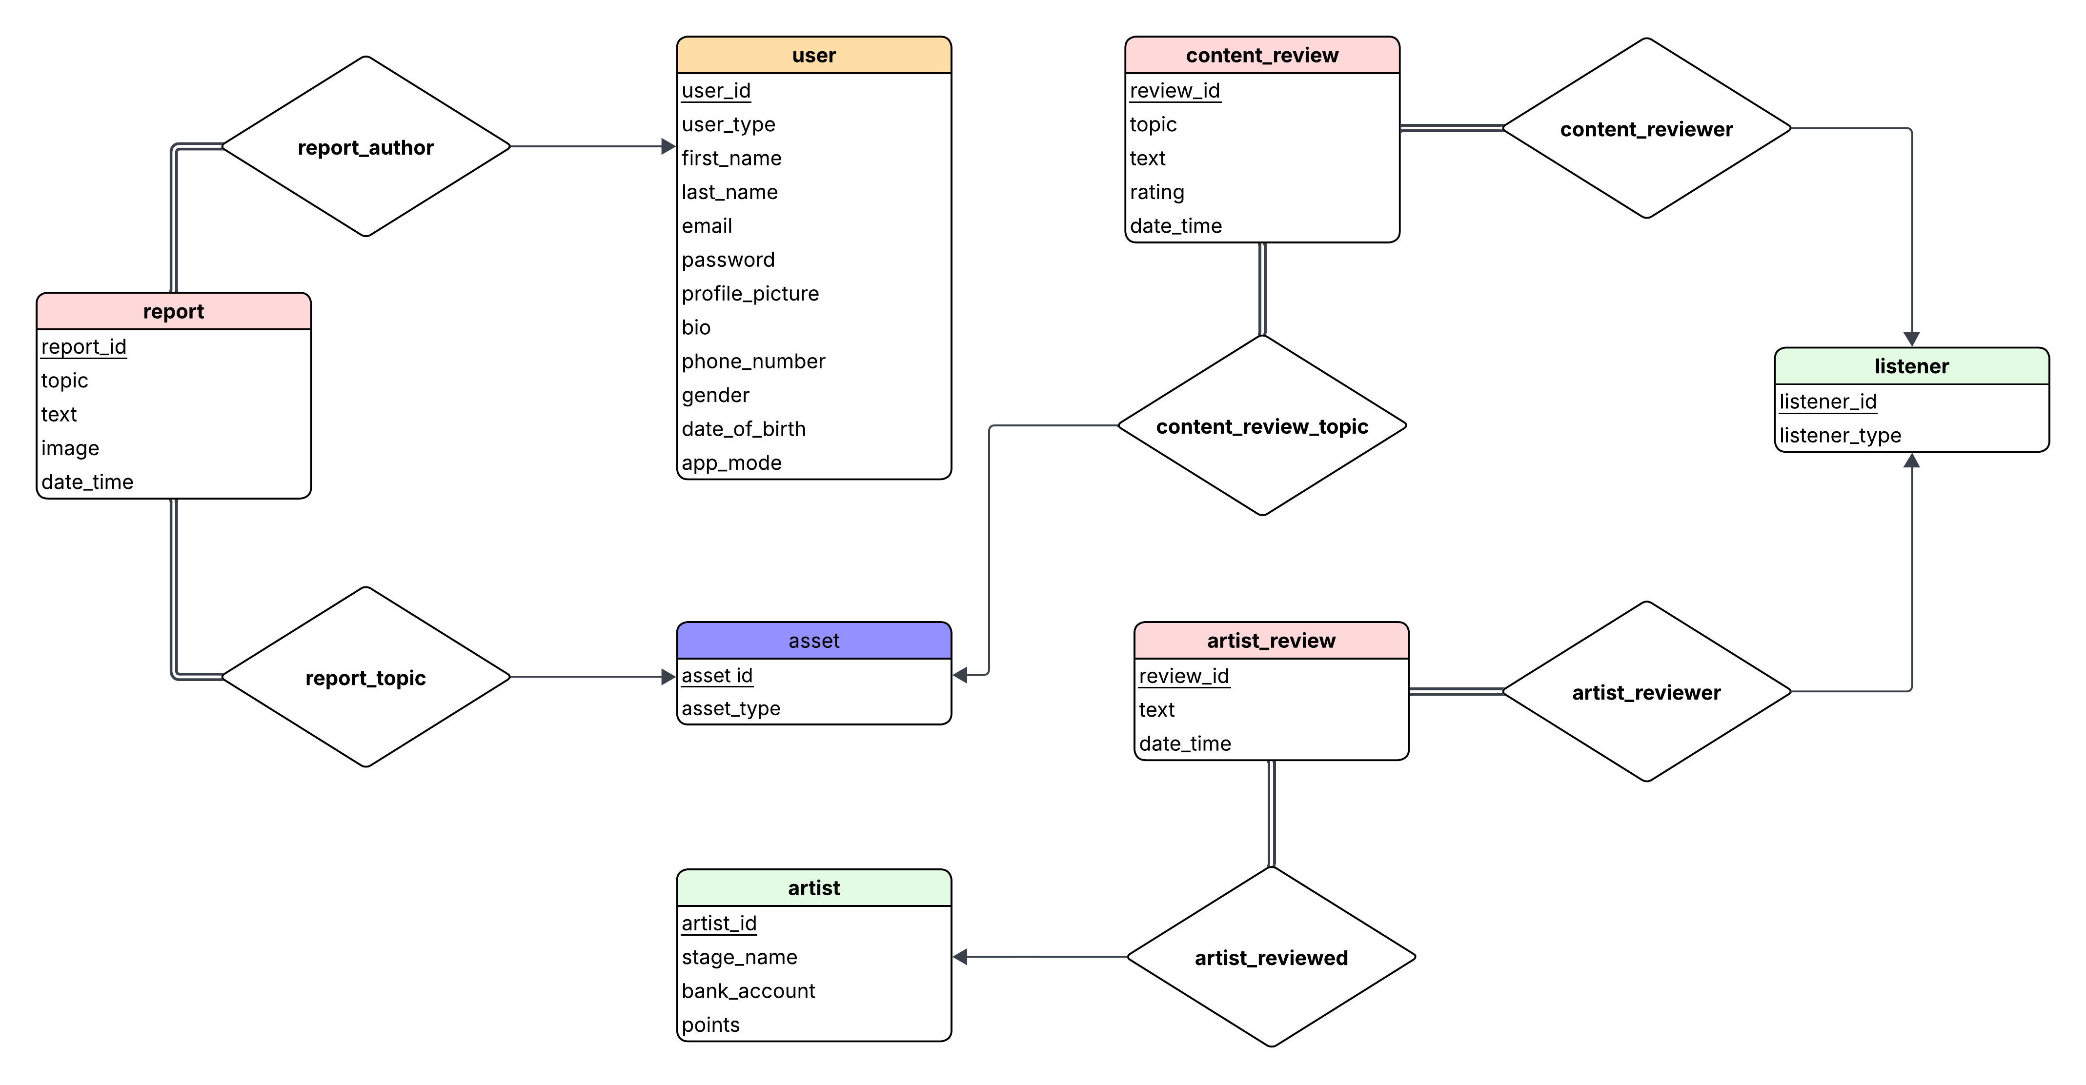
Review & Report

Slide 12
THANK YOU
Supervised by:
Kowshic Roy
Lecturer at CSE, BUET
Presented by:
Shadman Sami (2305043)
Ramisa Raidah Arana (2305049)

